Slide 1
Chapter 4 – C Program Control
Outline
4.1 Introduction
4.2 The Essentials of Repetition
4.3 Counter-Controlled Repetition
4.4 The for Repetition Statement
4.5 The for Statement: Notes and Observations
4.6 Examples Using the for Statement
4.7 The switch Multiple-Selection Statement
4.8 The do…while Repetition Statement
4.9 The break and continue Statements
4.10 Logical Operators
4.11 Confusing Equality (==) and Assignment (=) Operators
4.12 Structured Programming Summary

Slide 2
Objectives
In this chapter, you will learn:
  To be able to use the for and do…while repetition statements.
  To understand multiple selection using the switch selection statement.
  To be able to use the break and continue program control statements
  To be able to use the logical operators.

Slide 3
4.1 Introduction
This chapter introduces
  Additional repetition control structures
    for
    Do…while
  switch multiple selection statement
  break statement
    Used for exiting immediately and rapidly from certain control structures
  continue statement
    Used for skipping the remainder of the body of a repetition structure and proceeding with the next iteration of the loop

Slide 4
4.2 The Essentials of Repetition
Loop
  Group of instructions computer executes repeatedly while some condition remains true
Counter-controlled repetition
  Definite repetition: know how many times loop will execute
  Control variable used to count repetitions
Sentinel-controlled repetition
  Indefinite repetition
  Used when number of repetitions not known
  Sentinel value indicates "end of data"

Slide 5
4.3 Essentials of Counter-Controlled Repetition
Counter-controlled repetition requires
  The name of a control variable (or loop counter)
  The initial value of the control variable
  An increment (or decrement) by which the control variable is modified each time through the loop
  A condition that tests for the final value of the control variable (i.e., whether looping should continue)

Slide 6
4.3 Essentials of Counter-Controlled Repetition
Example:
    int counter = 1; // initialization
    while ( counter <= 10 ) { // repetition condition
    printf( "%d\n", counter );
    ++counter; // increment
    }
  The statement
      int counter = 1;
    Names counter
    Defines it to be an integer
    Reserves space for it in memory
    Sets it to an initial value of 1

Slide 7
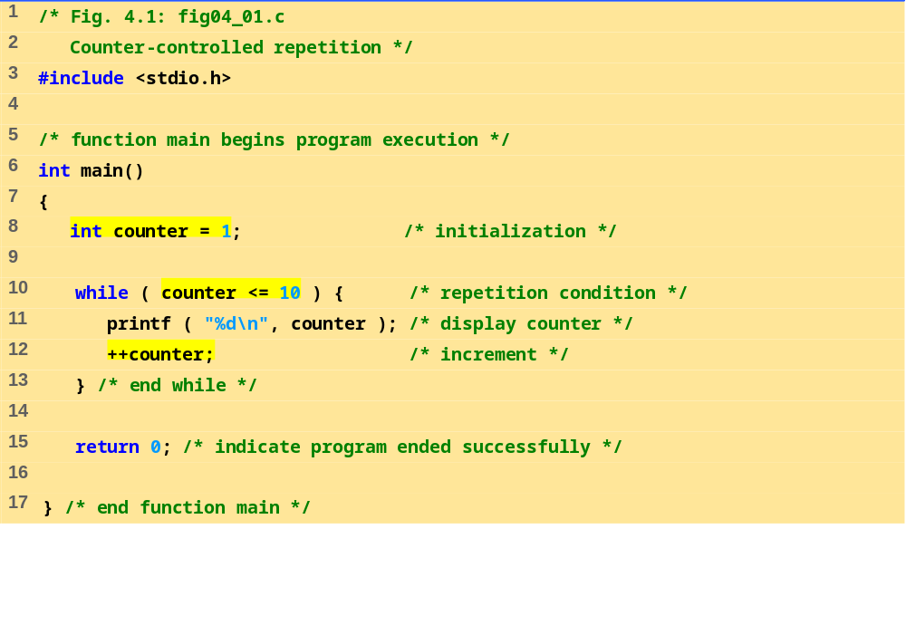
fig04_01.c
Program Output
1
2
3
4
5
6
7
8
9
10

Slide 8
4.3 Essentials of Counter-Controlled Repetition
Condensed code
  C Programmers would make the program more concise
  Initialize counter to 0
    while ( ++counter <= 10 )
    printf( “%d\n, counter );

Slide 9
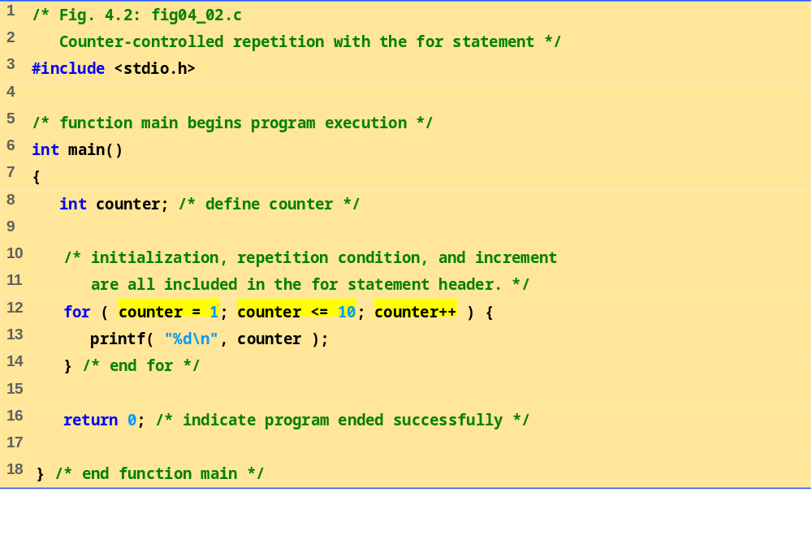
fig04_02.c

Slide 10
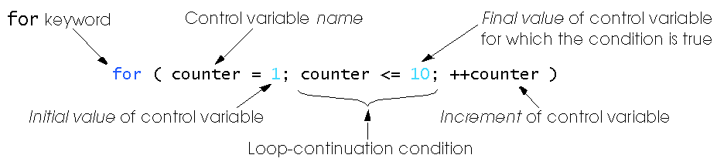
4.4 The for Repetition Statement

Slide 11
4.4 The for Repetition Statement
Format when using for loops
    for ( initialization; loopContinuationTest; increment )
    statement
Example:
    for( int counter = 1; counter <= 10; counter++ )
    printf( "%d\n", counter );
  Prints the integers from one to ten
No semicolon (;) after last expression

Slide 12
4.4 The for Repetition Statement
For loops can usually be rewritten as while loops:
    initialization;
    while ( loopContinuationTest ) {
    statement;
    increment;
    }
Initialization and increment
  Can be comma-separated lists
  Example:
    for (int i = 0, j = 0; j + i <= 10; j++, i++)
    printf( "%d\n", j + i );

Slide 13
4.5 The for Statement : Notes and Observations
Arithmetic expressions
  Initialization, loop-continuation, and increment can contain arithmetic expressions. If x equals 2 and y equals 10
    for ( j = x; j <= 4 * x * y; j += y / x )
  is equivalent to
    for ( j = 2; j <= 80; j += 5 )
Notes about the for statement:
  "Increment" may be negative (decrement)
  If the loop continuation condition is initially false
    The body of the for statement is not performed
    Control proceeds with the next statement after the for statement
  Control variable
    Often printed or used inside for body, but not necessary

Slide 14
4.5 The for Statement : Notes and Observations
Establish
initial
value
of control
variable
counter = 1
counter = 1
counter <= 10
true
printf( "%d", counter );
counter++
Increment
Determine if
final
the control
false
Body of loop
variable
value
of control
(this may be many
variable has been
statements)
reached

Slide 15
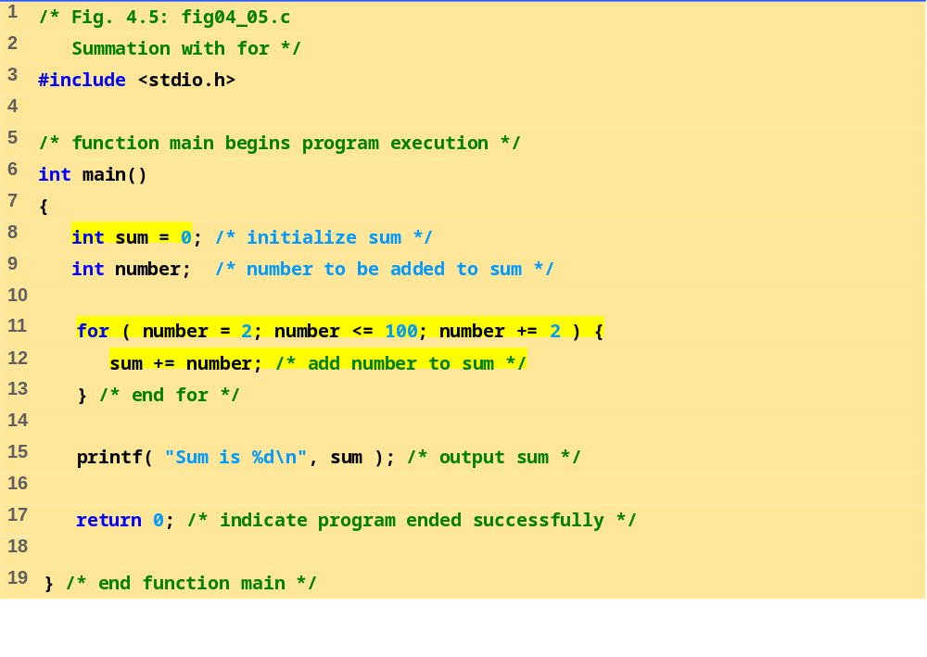
fig04_05.c
Program Output
Sum is 2550

Slide 16
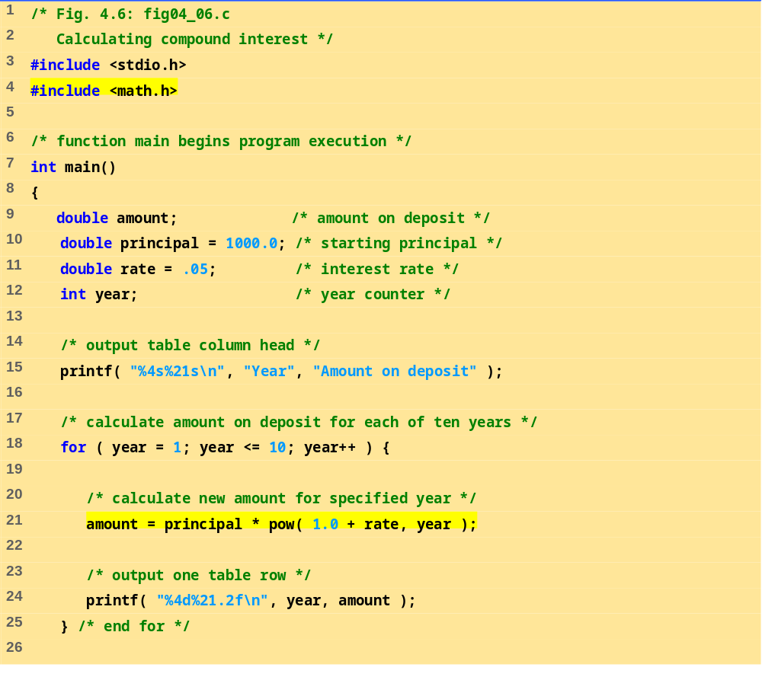
fig04_06.c (Part 1 of 2)

Slide 17
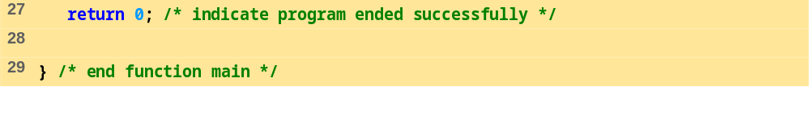
Year Amount on deposit
1 1050.00
2 1102.50
3 1157.63
4 1215.51
5 1276.28
6 1340.10
7 1407.10
8 1477.46
9 1551.33
10 1628.89
fig04_06.c (Part 2 of 2)
Program Output

Slide 18
4.7 The switch Multiple-Selection Statement
switch
  Useful when a variable or expression is tested for all the values it can assume and different actions are taken
Format
  Series of case labels and an optional default case
    switch ( value ){
      case '1':
        actions
      case '2':
        actions
      default:
        actions
      }
  break; exits from statement

Slide 19
4.7 The switch Multiple-Selection Statement
Flowchart of the switch statement
true
case a
case a action(s)
break
false
case b
true
case b action(s)
break
false
.
.
.
true
case z
case z action(s)
break
false
default action(s)

Slide 20
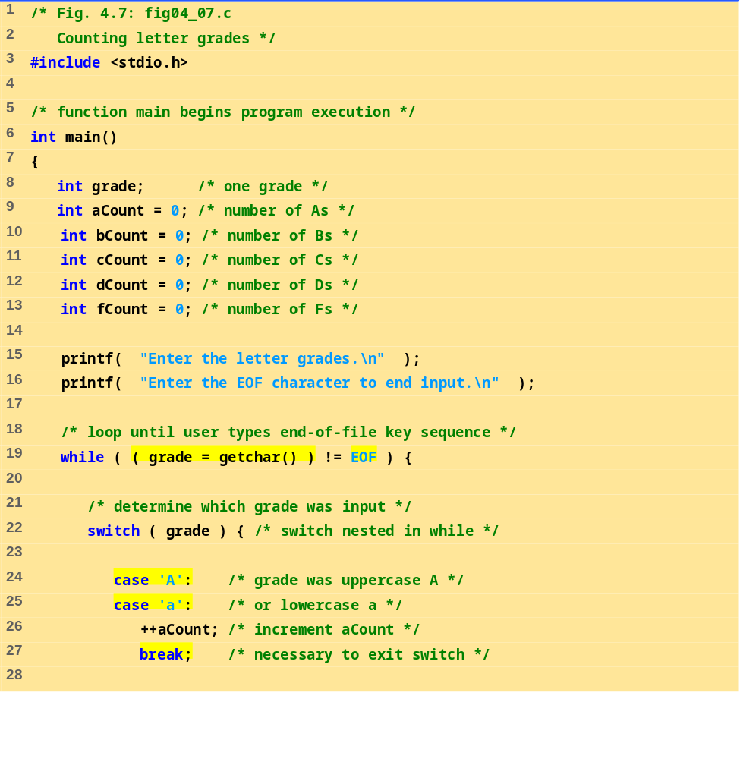
fig04_07.c (Part 1 of 3)

Slide 21
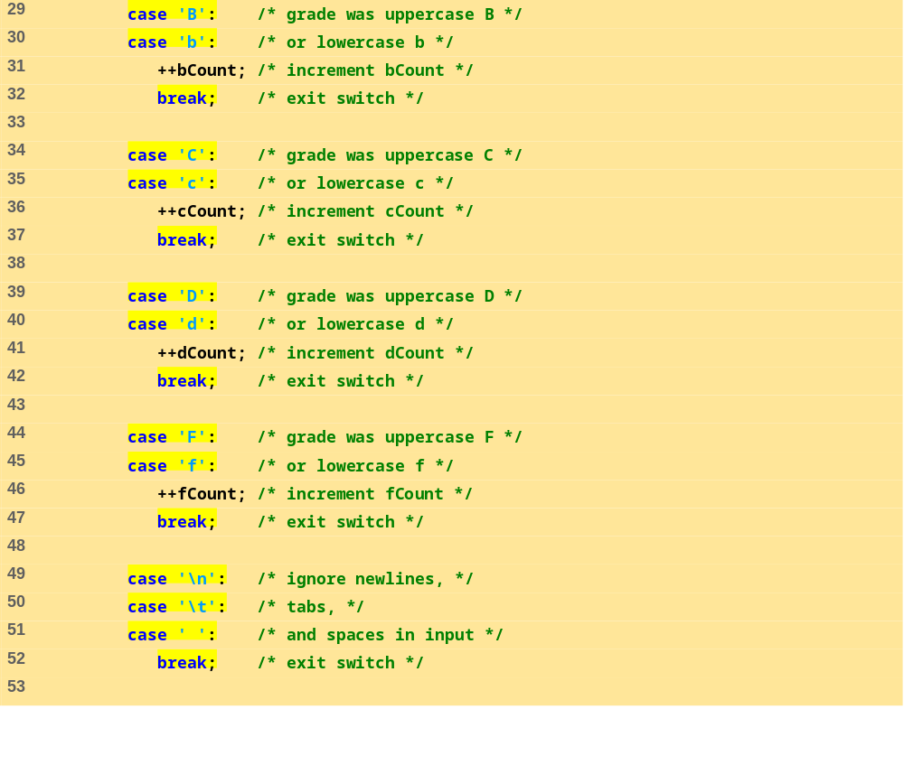
fig04_07.c (Part 2 of 3)

Slide 22
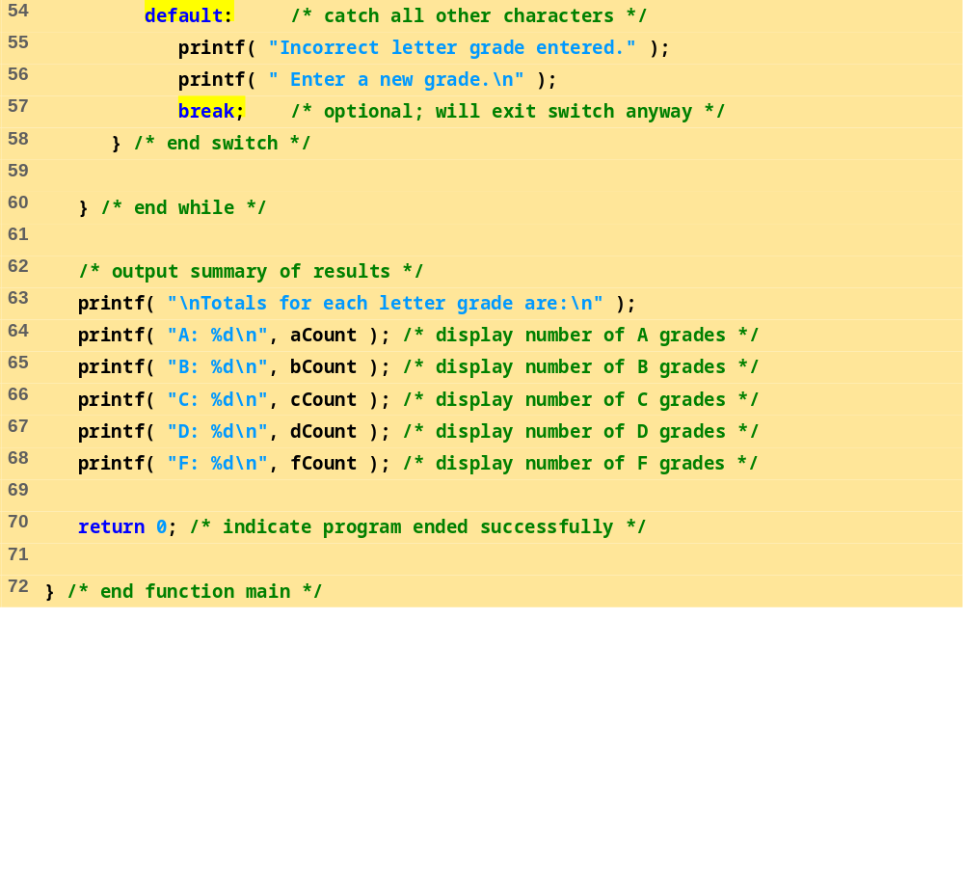
fig04_07.c (Part 3 of 3)

Slide 23
Enter the letter grades.
Enter the EOF character to end input.
a
b
c
C
A
d
f
C
E
Incorrect letter grade entered. Enter a new grade.
D
A
b
^Z
Totals for each letter grade are:
A: 3
B: 2
C: 3
D: 2
F: 1
Program Output

Slide 24
4.8 The do…while Repetition Statement
The do…while repetition statement
  Similar to the while structure
  Condition for repetition tested after the body of the loop is performed
    All actions are performed at least once
  Format:
      do {
      statement;
      } while ( condition );

Slide 25
4.8 The do…while Repetition Statement
Example (letting counter = 1):
      do {
      printf( "%d ", counter );
      } while (++counter <= 10);
  Prints the integers from 1 to 10

Slide 26
4.8 The do…while Repetition Statement
Flowchart of the do…while repetition statement
action(s)
true
condition
false

Slide 27
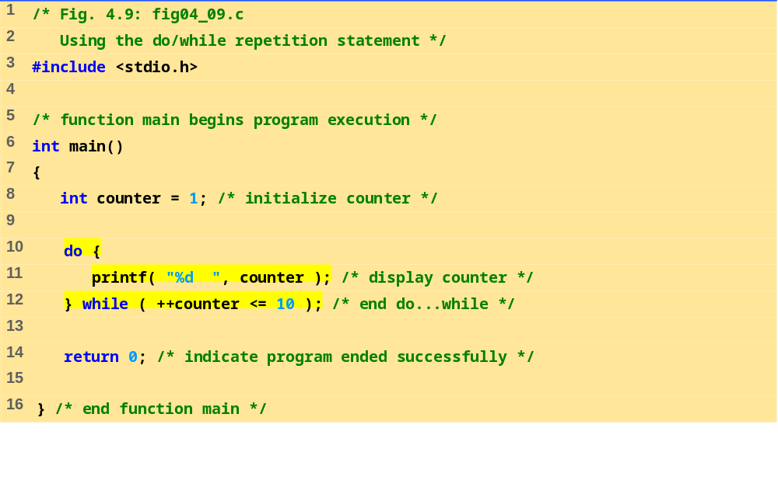
fig04_09.c
Program Output
1 2 3 4 5 6 7 8 9 10

Slide 28
4.9 The break and continue Statements
break
  Causes immediate exit from a while, for, do…while or switch statement
  Program execution continues with the first statement after the structure
  Common uses of the break statement
    Escape early from a loop
    Skip the remainder of a switch statement

Slide 29
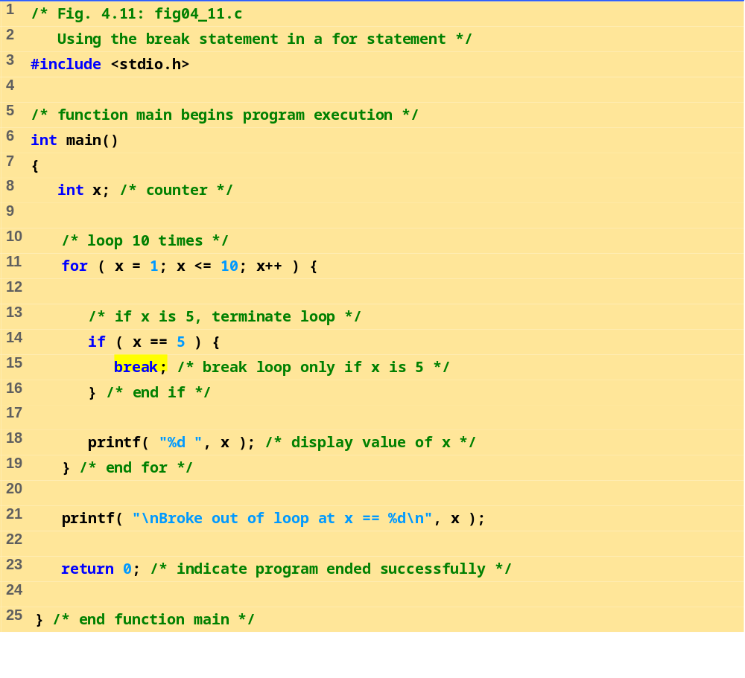
fig04_11.c
Program Output
1 2 3 4
Broke out of loop at x == 5

Slide 30
4.9 The break and continue Statements
continue
  Skips the remaining statements in the body of a while, for or do…while statement
    Proceeds with the next iteration of the loop
  while and do…while
    Loop-continuation test is evaluated immediately after the continue statement is executed
  for
    Increment expression is executed, then the loop-continuation test is evaluated

Slide 31
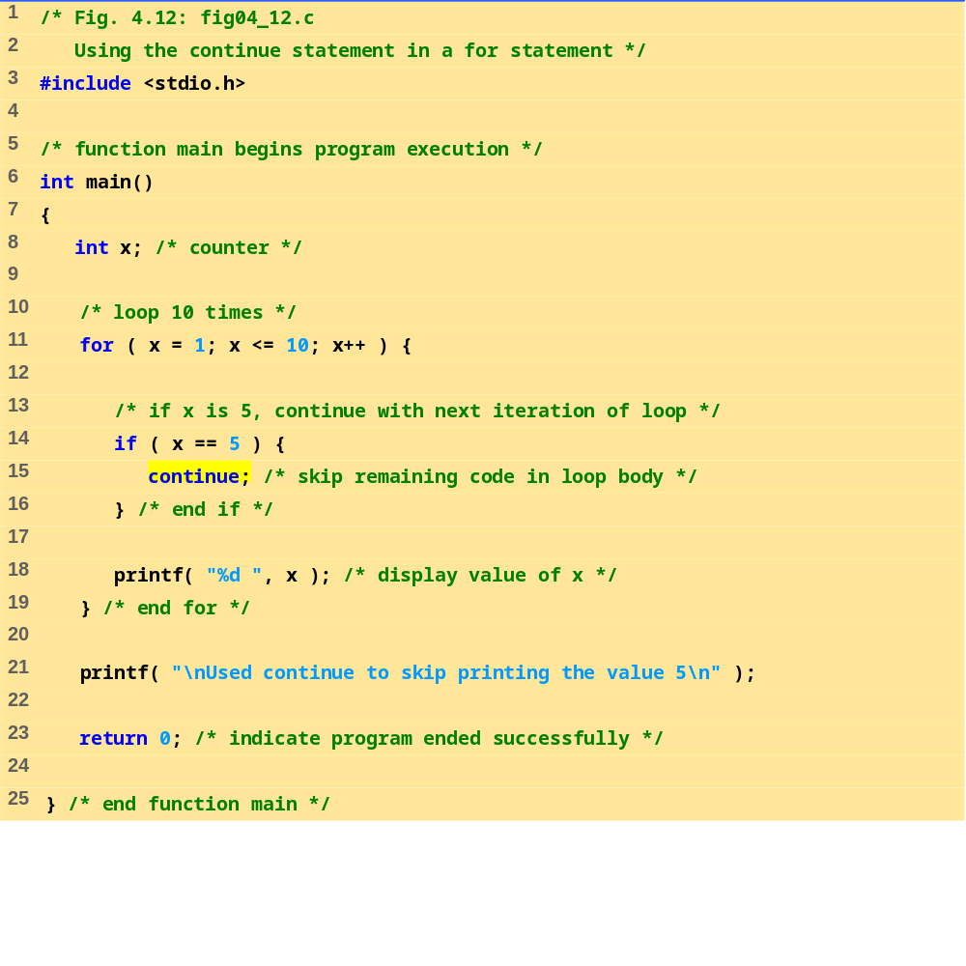
fig04_12.c
Program Output
1 2 3 4 6 7 8 9 10
Used continue to skip printing the value 5

Slide 32
4.10 Logical Operators
&& ( logical AND )
  Returns true if both conditions are true
|| ( logical OR )
  Returns true if either of its conditions are true
! ( logical NOT, logical negation )
  Reverses the truth/falsity of its condition
  Unary operator, has one operand
Useful as conditions in loops
    Expression Result
    true && false false
    true || false true
    !false true

Slide 33
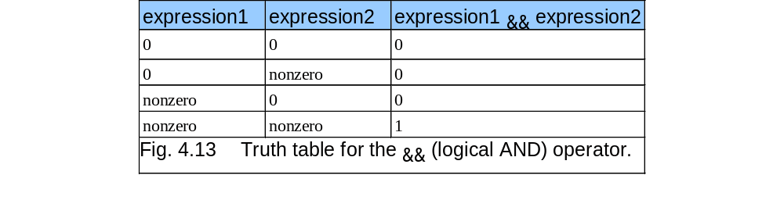
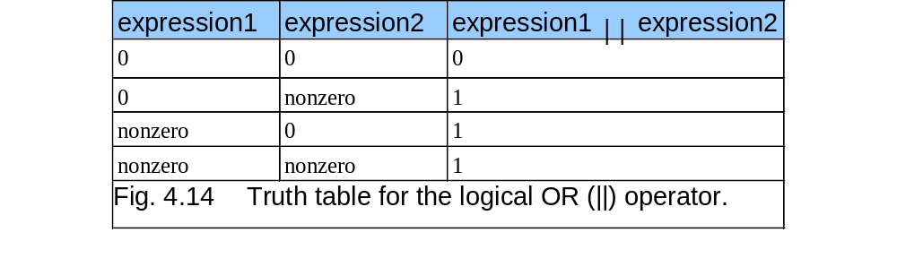
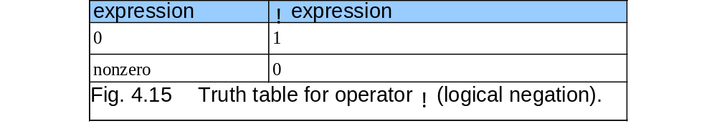
4.10 Logical Operators

Slide 34
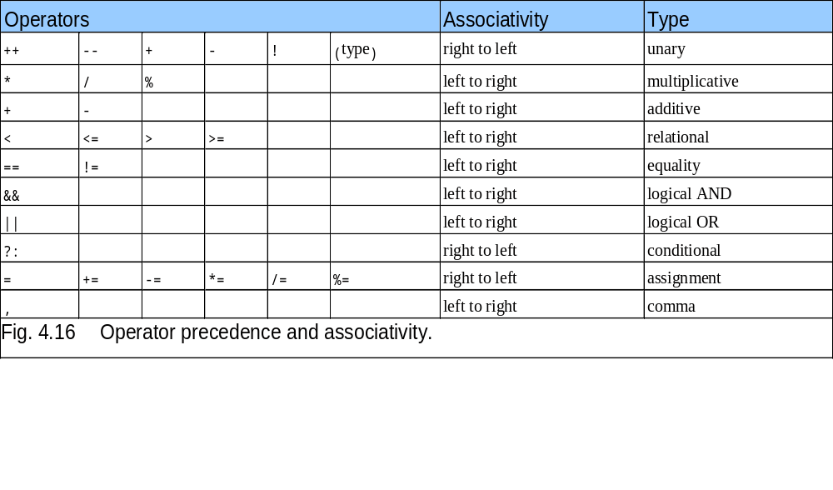
4.10 Logical Operators

Slide 35
4.11 Confusing Equality (==) and Assignment (=) Operators
Dangerous error
  Does not ordinarily cause syntax errors
  Any expression that produces a value can be used in control structures
  Nonzero values are true, zero values are false
  Example using ==:
      if ( payCode == 4 )
      printf( "You get a bonus!\n" );
    Checks payCode, if it is 4 then a bonus is awarded

Slide 36
4.11 Confusing Equality (==) and Assignment (=) Operators
  Example, replacing == with =:
      if ( payCode = 4 )
      printf( "You get a bonus!\n" );
    This sets payCode to 4
    4 is nonzero, so expression is true, and bonus awarded no matter what the payCode was
  Logic error, not a syntax error

Slide 37
4.11 Confusing Equality (==) and Assignment (=) Operators
lvalues
  Expressions that can appear on the left side of an equation
  Their values can be changed, such as variable names
    x = 4;
rvalues
  Expressions that can only appear on the right side of an equation
  Constants, such as numbers
    Cannot write 4 = x;
    Must write x = 4;
  lvalues can be used as rvalues, but not vice versa
    y = x;

Slide 38
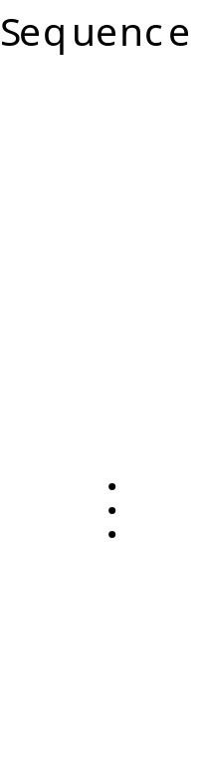
4.12 Structured-Programming Summary
Selection
if
statement
if…else
statement
(single selection)
(double selection)
T
F
T
F
switch
statement
(multiple selection)
T
break
F
T
break
F
.
.
.
T
break
F

Slide 39
4.12 Structured-Programming Summary
Repetition
while
statement
do
…
while
statement
for
statement
T
F
T
T
F
F

Slide 40
4.12 Structured-Programming Summary
Structured programming
  Easier than unstructured programs to understand, test, debug and, modify programs
Rules for structured programming
  Rules developed by programming community
  Only single-entry/single-exit control structures are used
  Rules:
    Begin with the “simplest flowchart”
    Stacking rule: Any rectangle (action) can be replaced by two rectangles (actions) in sequence
    Nesting rule: Any rectangle (action) can be replaced by any control structure (sequence, if, if…else, switch, while, do…while or for)
    Rules 2 and 3 can be applied in any order and multiple times

Slide 41
4.12 Structured-Programming Summary
Rule 2 - Any rectangle can be replaced by two rectangles in sequence
Rule 1 - Begin with the simplest flowchart
Rule 2
Rule 2
Rule 2
.
.
.

Slide 42
4.12 Structured-Programming Summary
Rule 3 - Replace any rectangle with a control structure
Rule 3
Rule 3
Rule 3

Slide 43
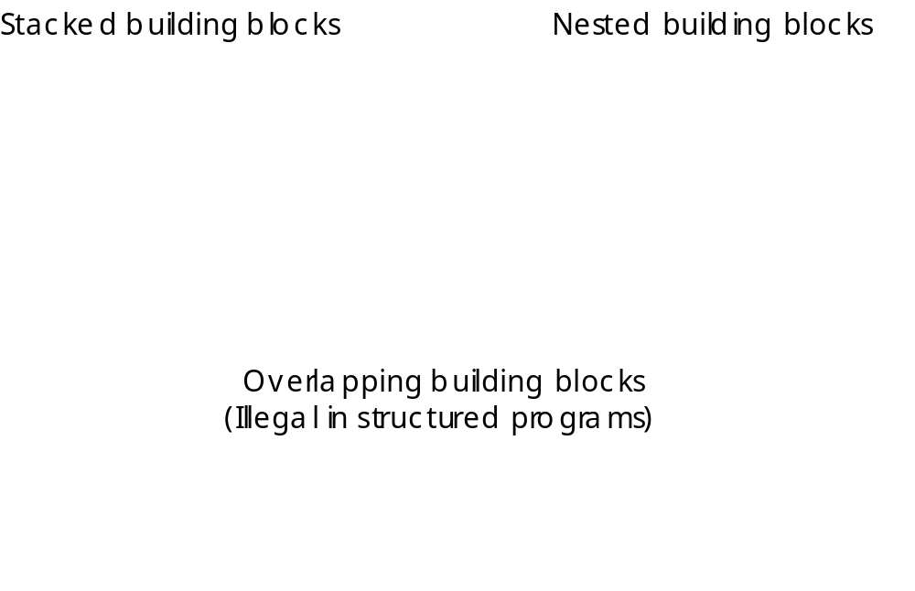
4.12 Structured-Programming Summary

Slide 44
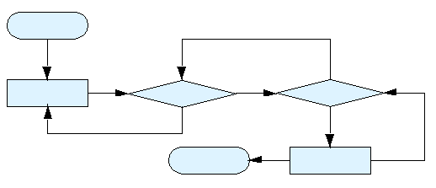
4.12 Structured-Programming Summary
Figure 4.23 An unstructured flowchart.

Slide 45
4.12 Structured-Programming Summary
All programs can be broken down into 3 controls
  Sequence – handled automatically by compiler
  Selection – if, if…else or switch
  Repetition – while, do…while or for
    Can only be combined in two ways
      Nesting (rule 3)
      Stacking (rule 2)
  Any selection can be rewritten as an if statement, and any repetition can be rewritten as a while statement

